Slide 1

Computer Programming
CC 102

Slide 2

HOW PEOPLE ACCESS THE WEB
Before we look at the code used to build websites it is important to consider the different ways in which people access the web and clarify some terminology
Notes:
Notes to presenter:
What is your purpose for sharing this reflection?
Is it at the end of a unit or project?
Are you sharing this reflection, at the attainment of a learning goal you set for yourself?
Is it at the end of a course?
State your purpose for the reflection or even the purpose of the learning experience or learning goal. Be clear and be specific in stating your purpose.

Slide 3

BROWSERS
People access websites using software called a web browser. Popular examples include Firefox, Internet Explorer, Safari, Chrome, and Opera.
In order to view a web page, users might type a web address into their browser, follow a link from another site, or use a bookmark
People access websites using software called a web browser. Popular examples include Firefox, Internet Explorer, Safari, Chrome, and Opera. In order to view a web page, users might type a web address into their browser, follow a link from another site, or use a bookmark
Notes:
Notes to presenter:
Description of what you learned in your own words on one side.
Include information about the topic
Details about the topic will also be helpful here.
Tell the story of your learning experience. Just like a story there should always be a beginning, middle and an end.
On the other side, you can add a graphic that provides evidence of what you learned.
Feel free to use more than one slide to reflect upon your process. It also helps to add some video of your process.

Slide 4
WEB SERVERS
When you ask your browser for a web page, the request is sent across the Internet to a special computer known as a web server which hosts the website.
Web servers are special computers that are constantly connected to the Internet, and are optimized to send web pages out to people who request them.
Some big companies run their own web servers, but it is more common to use the services of a web hosting company who charge a fee to host your site.
Notes:
Notes to presenter:
Description of what you learned in your own words on one side.
Include information about the topic
Details about the topic will also be helpful here.
Tell the story of your learning experience. Just like a story there should always be a beginning, middle and an end.
On the other side, you can add a graphic that provides evidence of what you learned.
Feel free to use more than one slide to reflect upon your process. It also helps to add some video of your process.

Slide 5
DEVICES
People are accessing websites on an increasing range of devices including desktop computers, laptops, tablets, and mobile phones. It is important to remember that various devices have different screen sizes and some have faster connections to the web than others.
Notes:
Notes to presenter:
Description of what you learned in your own words on one side.
Include information about the topic
Details about the topic will also be helpful here.
Tell the story of your learning experience. Just like a story there should always be a beginning, middle and an end.
On the other side, you can add a graphic that provides evidence of what you learned.
Feel free to use more than one slide to reflect upon your process. It also helps to add some video of your process.

Slide 6
SCREEN READERS
Screen readers are programs that read out the contents of a computer screen to a user. They are commonly used by people with visual impairments.
In the same way that many countries have legislations that require public buildings to be accessible to those with disabilities, many laws have also been passed that require websites be accessible to those with disabilities.
Throughout this book you will see several references to screen readers. These notes will help ensure that the sites you create are accessible to people who use such software.
It is interesting to note that technologies similar to those employed by screen readers are also being used in other areas where people are unable read a screen, such as when they are driving or jogging
Notes:
Notes to presenter:
Description of what you learned in your own words on one side.
Include information about the topic
Details about the topic will also be helpful here.
Tell the story of your learning experience. Just like a story there should always be a beginning, middle and an end.
On the other side, you can add a graphic that provides evidence of what you learned.
Feel free to use more than one slide to reflect upon your process. It also helps to add some video of your process.

Slide 7
HOW WEBSITES ARE CREATED
All websites use HTML and CSS, but content management systems, blogging software, and e-commerce platforms often add a few more technologies into the mix.
Notes:
Notes to presenter:
What is your purpose for sharing this reflection?
Is it at the end of a unit or project?
Are you sharing this reflection, at the attainment of a learning goal you set for yourself?
Is it at the end of a course?
State your purpose for the reflection or even the purpose of the learning experience or learning goal. Be clear and be specific in stating your purpose.

Slide 8
WHAT YOU SEE
When you are looking at a website, it is most likely that your browser will be receiving HTML and CSS from the web server that hosts the site. The web browser interprets the HTML and CSS code to create the page that you see.
Most web pages also include extra content such as images, audio, video, or animations and this LMS will teach you how to prepare them for use on the web and then how to insert them into your web pages.
Some sites also send JavaScript or Flash to your browser, and you will see how to add JavaScript and Flash in your web pages. Both of these technologies are advanced topics that you can go on to learn more about once you have mastered HTML and CSS, if you want to.
Notes:
Notes to presenter:
Description of what you learned in your own words on one side.
Include information about the topic
Details about the topic will also be helpful here.
Tell the story of your learning experience. Just like a story there should always be a beginning, middle and an end.
On the other side, you can add a graphic that provides evidence of what you learned.
Feel free to use more than one slide to reflect upon your process. It also helps to add some video of your process.

Slide 9
HOW IT IS CREATED
Small websites are often written just using HTML and CSS. Larger websites — in particular those that are updated regularly and use a content management system (CMS), blogging tools, or e-commerce software — often make use of more complex technologies on the web server, but these technologies are actually used to produce HTML and CSS that is then sent to the browser. So, if your site uses these technologies, you will be able to use your new HTML and CSS knowledge to take more control over how your site looks.
Larger, more complex sites like these may use a database to store data, and programming languages such as PHP, ASP.Net, Java, or Ruby on the web server, but you do not need to know these technologies to improve what the user sees. The skills you'll learn in this book should be enough to help you on that road.
Notes:
Notes to presenter:
Description of what you learned in your own words on one side.
Include information about the topic
Details about the topic will also be helpful here.
Tell the story of your learning experience. Just like a story there should always be a beginning, middle and an end.
On the other side, you can add a graphic that provides evidence of what you learned.
Feel free to use more than one slide to reflect upon your process. It also helps to add some video of your process.

Slide 10
HTML 5 & CSS3
HTML5 is a programming language whose acronym stands for Hyper Text Markup Language. It is a system that allows the modification of the appearance of web pages, as well as making adjustments to their appearance. It also used to structure and present content for the web. CSS3 is the latest evolution of the Cascading Style Sheets language and aims at extending CSS2.1. It brings a lot of new features and additions, like rounded corners, shadows, gradients, transitions or animations, as well as new layouts like multi-columns, flexible box or grid layouts.
Notes:
Notes to presenter:
Description of what you learned in your own words on one side.
Include information about the topic
Details about the topic will also be helpful here.
Tell the story of your learning experience. Just like a story there should always be a beginning, middle and an end.
On the other side, you can add a graphic that provides evidence of what you learned.
Feel free to use more than one slide to reflect upon your process. It also helps to add some video of your process.

Slide 11
STRUCTURE
Understanding structure
Learning about markup
Tags and Elements
Notes:
Notes to presenter:
What is your purpose for sharing this reflection?
Is it at the end of a unit or project?
Are you sharing this reflection, at the attainment of a learning goal you set for yourself?
Is it at the end of a course?
State your purpose for the reflection or even the purpose of the learning experience or learning goal. Be clear and be specific in stating your purpose.

Slide 12
STRUCTURE
We come across all kinds of documents every day of our lives. Newspapers, insurance forms, shop catalogues... the list goes on.
Many web pages act like electronic versions of these documents. For example, newspapers show the same stories in print as they do on websites; you can apply for insurance over the web; and stores have online catalogs and e-commerce facilities
Notes:
Notes to presenter:
Description of what you learned in your own words on one side.
Include information about the topic
Details about the topic will also be helpful here.
Tell the story of your learning experience. Just like a story there should always be a beginning, middle and an end.
On the other side, you can add a graphic that provides evidence of what you learned.
Feel free to use more than one slide to reflect upon your process. It also helps to add some video of your process.

Slide 13
STRUCTURE
In all kinds of documents, structure is very important in helping readers to understand the messages you are trying to convey and to navigate around the document. So, in order to learn how to write web pages, it is very important to understand how to structure documents. In this chapter you will:
● See how HTML describes the structure of a web page
● Learn how tags or elements are added to your document
● Write your first web page
Notes:
Notes to presenter:
Description of what you learned in your own words on one side.
Include information about the topic
Details about the topic will also be helpful here.
Tell the story of your learning experience. Just like a story there should always be a beginning, middle and an end.
On the other side, you can add a graphic that provides evidence of what you learned.
Feel free to use more than one slide to reflect upon your process. It also helps to add some video of your process.

Slide 14
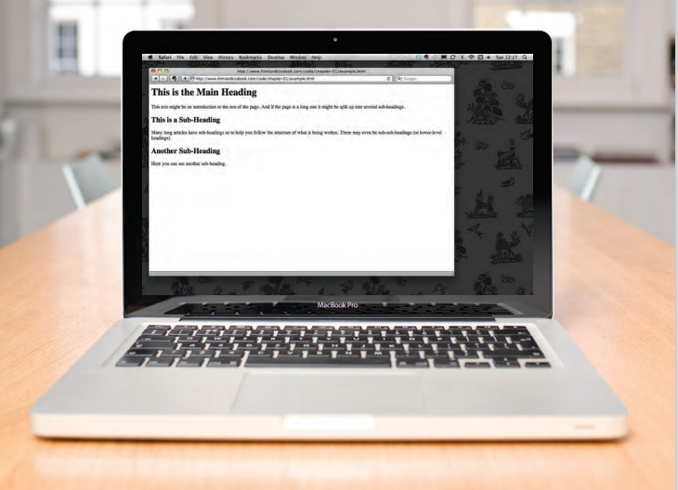
STRUCTURE
Notes:
Notes to presenter:
Description of what you learned in your own words on one side.
Include information about the topic
Details about the topic will also be helpful here.
Tell the story of your learning experience. Just like a story there should always be a beginning, middle and an end.
On the other side, you can add a graphic that provides evidence of what you learned.
Feel free to use more than one slide to reflect upon your process. It also helps to add some video of your process.

Slide 15
HOW PAGES USE STRUCTURE
Think about the stories you read in a newspaper: for each story, there will be a headline, some text, and possibly some images. If the article is a long piece, there may be subheadings that split the story into separate sections or quotes from those involved. Structure helps readers understand the stories in the newspaper.
The structure is very similar when a news story is viewed online (although it may also feature audio or video). This is illustrated on the right with a copy of a newspaper alongside the corresponding article on its website.
Now think about a very different type of document — an insurance form. Insurance forms often have headings for different sections, and each section contains a list of questions with areas for you to fill in details or checkboxes to tick. Again, the structure is very similar online.
Notes:
Notes to presenter:
Description of what you learned in your own words on one side.
Include information about the topic
Details about the topic will also be helpful here.
Tell the story of your learning experience. Just like a story there should always be a beginning, middle and an end.
On the other side, you can add a graphic that provides evidence of what you learned.
Feel free to use more than one slide to reflect upon your process. It also helps to add some video of your process.

Slide 16
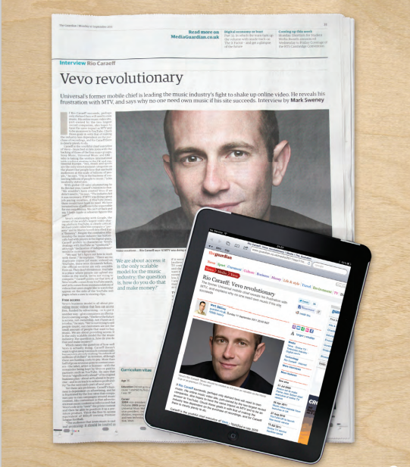
HOW PAGES USE STRUCTURE
Notes:
Notes to presenter:
Description of what you learned in your own words on one side.
Include information about the topic
Details about the topic will also be helpful here.
Tell the story of your learning experience. Just like a story there should always be a beginning, middle and an end.
On the other side, you can add a graphic that provides evidence of what you learned.
Feel free to use more than one slide to reflect upon your process. It also helps to add some video of your process.

Slide 17
STRUCTURING WORD DOCUMENTES
The use of headings and subheadings in any document often reflects a hierarchy of information. For example, a document might start with a large heading, followed by an introduction or the most important information.
This might be expanded upon under subheadings lower down on the page. When using a word processor to create a document, we separate out the text to give it structure. Each topic might have a new paragraph, and each section can have a heading to describe what it covers.
On the right, you can see a simple document in Microsoft Word. The different styles for the document, such as different levels of heading, are shown in the drop down box. If you regularly use Word, you might have also used the formatting toolbar or palette to do this.
Notes:
Notes to presenter:
Description of what you learned in your own words on one side.
Include information about the topic
Details about the topic will also be helpful here.
Tell the story of your learning experience. Just like a story there should always be a beginning, middle and an end.
On the other side, you can add a graphic that provides evidence of what you learned.
Feel free to use more than one slide to reflect upon your process. It also helps to add some video of your process.

Slide 18
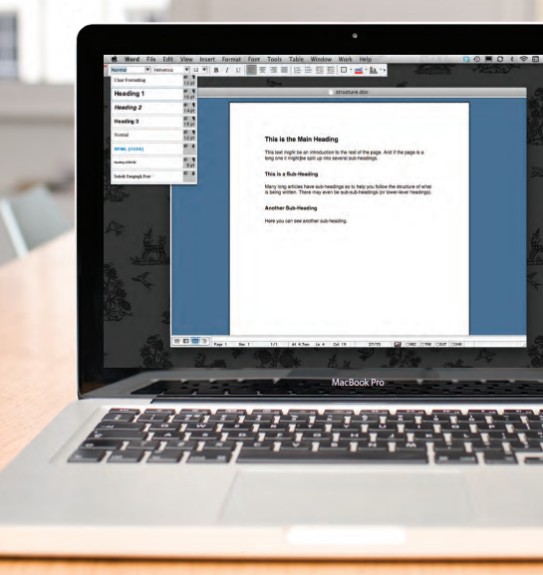
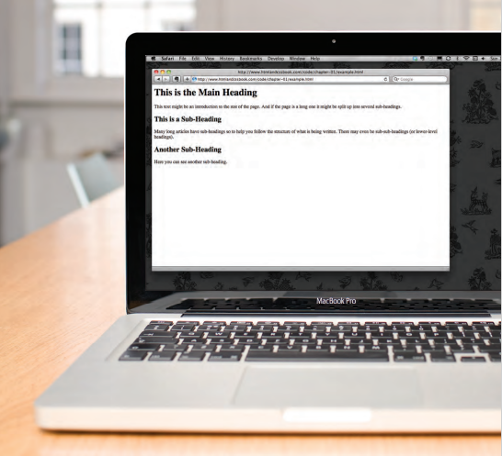
STRUCTURING WORD DOCUMENTES
On the previous IMAGE you saw how structure was added to a Word document to make it easier to understand. We use structure in the same way when writing web pages
Notes:
Notes to presenter:
Description of what you learned in your own words on one side.
Include information about the topic
Details about the topic will also be helpful here.
Tell the story of your learning experience. Just like a story there should always be a beginning, middle and an end.
On the other side, you can add a graphic that provides evidence of what you learned.
Feel free to use more than one slide to reflect upon your process. It also helps to add some video of your process.

Slide 19
HTML DESCRIBES THE STRUCTURES OF PAGES
In the browser window you can see a web page that features exactly the same content as the Word document you met on the page 18. To describe the structure of a web page, we add code to the words we want to appear on the page.
You can see the HTML code for this page below. Don't worry about what the code means yet. We start to look at it in more detail on the next page. Note that the HTML code is in blue, and the text you see on screen is in black
Notes:
Notes to presenter:
Description of what you learned in your own words on one side.
Include information about the topic
Details about the topic will also be helpful here.
Tell the story of your learning experience. Just like a story there should always be a beginning, middle and an end.
On the other side, you can add a graphic that provides evidence of what you learned.
Feel free to use more than one slide to reflect upon your process. It also helps to add some video of your process.

Slide 20
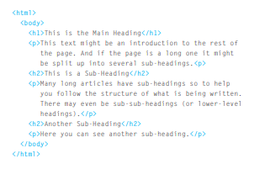
HTML DESCRIBES THE STRUCTURES OF PAGES
Notes:
Notes to presenter:
Description of what you learned in your own words on one side.
Include information about the topic
Details about the topic will also be helpful here.
Tell the story of your learning experience. Just like a story there should always be a beginning, middle and an end.
On the other side, you can add a graphic that provides evidence of what you learned.
Feel free to use more than one slide to reflect upon your process. It also helps to add some video of your process.

Slide 21
HTML USES ELEMENTS TO DESCRIBE THE STRUCTURE OF PAGES
Let's look closer at the code from the last page. There are several different elements. Each element has an opening tag and a closing tag
Notes:
Notes to presenter:
What is your purpose for sharing this reflection?
Is it at the end of a unit or project?
Are you sharing this reflection, at the attainment of a learning goal you set for yourself?
Is it at the end of a course?
State your purpose for the reflection or even the purpose of the learning experience or learning goal. Be clear and be specific in stating your purpose.

Slide 22
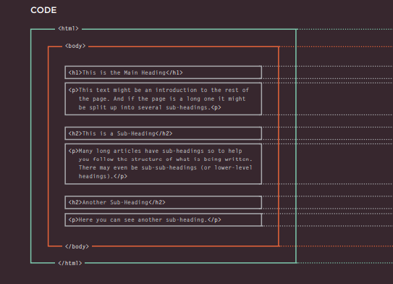
HTML DESCRIBES THE STRUCTURES OF PAGES
Notes:
Notes to presenter:
Description of what you learned in your own words on one side.
Include information about the topic
Details about the topic will also be helpful here.
Tell the story of your learning experience. Just like a story there should always be a beginning, middle and an end.
On the other side, you can add a graphic that provides evidence of what you learned.
Feel free to use more than one slide to reflect upon your process. It also helps to add some video of your process.

Slide 23
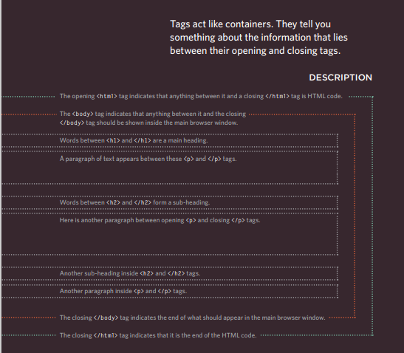
HTML DESCRIBES THE STRUCTURES OF PAGES
Notes:
Notes to presenter:
Description of what you learned in your own words on one side.
Include information about the topic
Details about the topic will also be helpful here.
Tell the story of your learning experience. Just like a story there should always be a beginning, middle and an end.
On the other side, you can add a graphic that provides evidence of what you learned.
Feel free to use more than one slide to reflect upon your process. It also helps to add some video of your process.

Slide 24
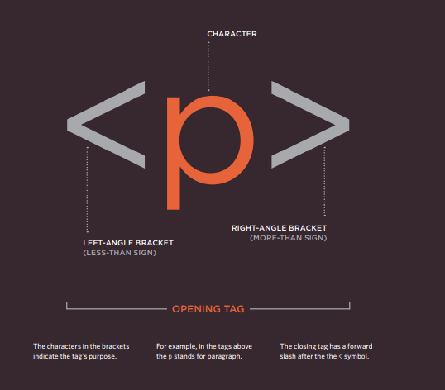
A CLOSER LOOK AT TAGS
Notes:
Notes to presenter:
Description of what you learned in your own words on one side.
Include information about the topic
Details about the topic will also be helpful here.
Tell the story of your learning experience. Just like a story there should always be a beginning, middle and an end.
On the other side, you can add a graphic that provides evidence of what you learned.
Feel free to use more than one slide to reflect upon your process. It also helps to add some video of your process.

Slide 25
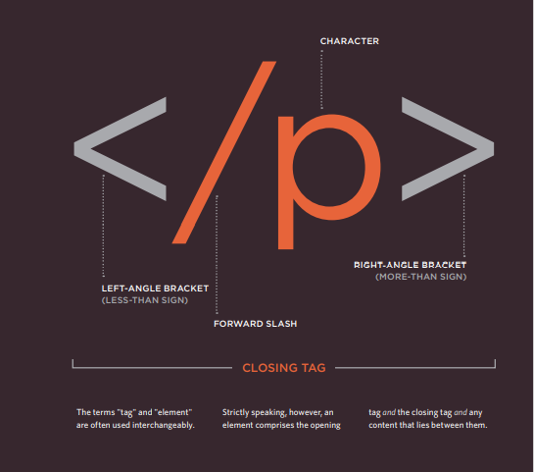
A CLOSER LOOK AT TAGS
Notes:
Notes to presenter:
Description of what you learned in your own words on one side.
Include information about the topic
Details about the topic will also be helpful here.
Tell the story of your learning experience. Just like a story there should always be a beginning, middle and an end.
On the other side, you can add a graphic that provides evidence of what you learned.
Feel free to use more than one slide to reflect upon your process. It also helps to add some video of your process.

Slide 26
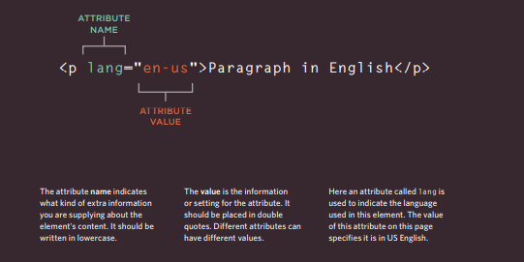
Attributes Tell Us More About Elements
Attributes provide additional information about the contents of an element. They appear on the opening tag of the element and are made up of two parts: a name and a value, separated by an equals sign.
Notes:
Notes to presenter:
Description of what you learned in your own words on one side.
Include information about the topic
Details about the topic will also be helpful here.
Tell the story of your learning experience. Just like a story there should always be a beginning, middle and an end.
On the other side, you can add a graphic that provides evidence of what you learned.
Feel free to use more than one slide to reflect upon your process. It also helps to add some video of your process.

Slide 27
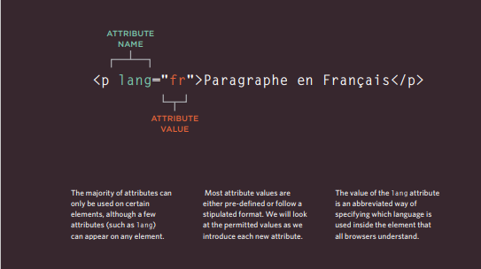
Attributes Tell Us More About Elements
HTML5 allows you to use uppercase attribute names and omit the quotemarks, but this is not recommended.
Notes:
Notes to presenter:
Description of what you learned in your own words on one side.
Include information about the topic
Details about the topic will also be helpful here.
Tell the story of your learning experience. Just like a story there should always be a beginning, middle and an end.
On the other side, you can add a graphic that provides evidence of what you learned.
Feel free to use more than one slide to reflect upon your process. It also helps to add some video of your process.

Slide 28
BODY, HEAD & TITLE
<body>
You met the <body> element in the first example we created. Everything inside this element is show inside the main browser window.
<head>
Before the <body> element you will often see a <head> element. This contains information about the page (rather than information that is show within the main part of the browser window that is highlighted in blue on the opposite page). You will usually find a <title> element inside the <head> element.
<title>
The contents of the <title> element are either show in the top of the brower, above where you usually type in the URL of the page you want to visit, or on the tab for that page (if your browser uses tabas to allow you to view multiple pages at the same time).
Notes:
Notes to presenter:
Description of what you learned in your own words on one side.
Include information about the topic
Details about the topic will also be helpful here.
Tell the story of your learning experience. Just like a story there should always be a beginning, middle and an end.
On the other side, you can add a graphic that provides evidence of what you learned.
Feel free to use more than one slide to reflect upon your process. It also helps to add some video of your process.

Slide 29
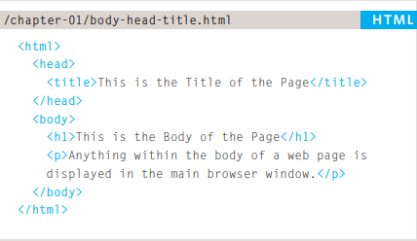
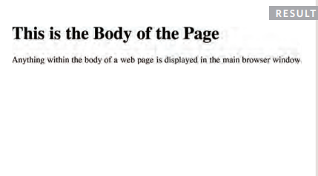
BODY, HEAD & TITLE
Notes:
Notes to presenter:
Description of what you learned in your own words on one side.
Include information about the topic
Details about the topic will also be helpful here.
Tell the story of your learning experience. Just like a story there should always be a beginning, middle and an end.
On the other side, you can add a graphic that provides evidence of what you learned.
Feel free to use more than one slide to reflect upon your process. It also helps to add some video of your process.

Slide 30
TEXT
Headings and paragraphs
Bold, italic, emphasis
Structural and semantic markup
Notes:
Notes to presenter:
What is your purpose for sharing this reflection?
Is it at the end of a unit or project?
Are you sharing this reflection, at the attainment of a learning goal you set for yourself?
Is it at the end of a course?
State your purpose for the reflection or even the purpose of the learning experience or learning goal. Be clear and be specific in stating your purpose.

Slide 31
Text
When creating a web page, you add tags (known as markup) to the contents of the page. These tags provide extra meaning and allow browsers to show users the In this chapter we focus on how to add markup to the text that appears on your pages. You will learn about:
● Structural markup: the elements that you can use to describe both headings and paragraphs
● Semantic markup: which provides extra information; such as where emphasis is placed in a sentence, that something you have written is a quotation (and who said it), the meaning of acronyms, and so on
Notes:
Notes to presenter:
Description of what you learned in your own words on one side.
Include information about the topic
Details about the topic will also be helpful here.
Tell the story of your learning experience. Just like a story there should always be a beginning, middle and an end.
On the other side, you can add a graphic that provides evidence of what you learned.
Feel free to use more than one slide to reflect upon your process. It also helps to add some video of your process.

Slide 32
HEADINGS
HTML has six "levels" of headings:
<h1>is used for main headings
<h2>is used for subheadings
If there are further sections under the subheadings then the element <h3> is used, and so on...
Browsers display the contents of headings at different sizes. The contents of an <h1> element is the largest, and the contents of an <h6> element is the smallest. The exact size at which each browser shows the headings can vary slightly. Users can also adjust the size of text in their browser. You will see how to control the size of text, its color, and the fonts used when we come to look at CSS.
<h1>
<h2>
<h3>
<h4>
<h5>
<h6>
Notes:
Notes to presenter:
Description of what you learned in your own words on one side.
Include information about the topic
Details about the topic will also be helpful here.
Tell the story of your learning experience. Just like a story there should always be a beginning, middle and an end.
On the other side, you can add a graphic that provides evidence of what you learned.
Feel free to use more than one slide to reflect upon your process. It also helps to add some video of your process.

Slide 33
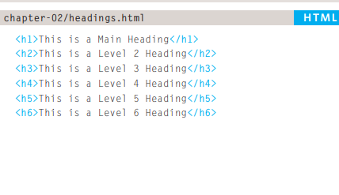
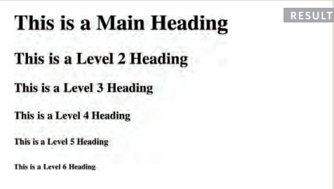
HEADINGS
Notes:
Notes to presenter:
Description of what you learned in your own words on one side.
Include information about the topic
Details about the topic will also be helpful here.
Tell the story of your learning experience. Just like a story there should always be a beginning, middle and an end.
On the other side, you can add a graphic that provides evidence of what you learned.
Feel free to use more than one slide to reflect upon your process. It also helps to add some video of your process.

Slide 34
PARAGRAPHS
<p>
To create a paragraph, surround the words that make up the paragraph with an opening <p> tag and closing </p> tag.
By default, a browser will show each paragraph on a new line with some space between it and any subsequent paragraphs.
Notes:
Notes to presenter:
Description of what you learned in your own words on one side.
Include information about the topic
Details about the topic will also be helpful here.
Tell the story of your learning experience. Just like a story there should always be a beginning, middle and an end.
On the other side, you can add a graphic that provides evidence of what you learned.
Feel free to use more than one slide to reflect upon your process. It also helps to add some video of your process.

Slide 35
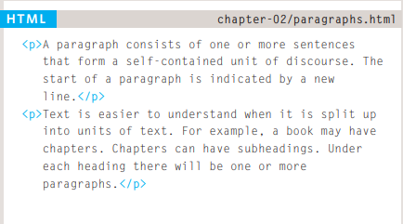
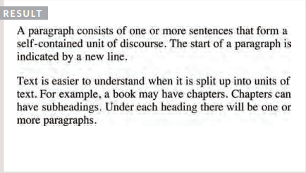
PARAGRAPHS
Notes:
Notes to presenter:
Description of what you learned in your own words on one side.
Include information about the topic
Details about the topic will also be helpful here.
Tell the story of your learning experience. Just like a story there should always be a beginning, middle and an end.
On the other side, you can add a graphic that provides evidence of what you learned.
Feel free to use more than one slide to reflect upon your process. It also helps to add some video of your process.

Slide 36
BOLD
<b>
By enclosing words in the tags <b> and </b> we can make characters appear bold.
The <b> element also represents a section of text that would be presented in a visually different way (for example key words in a paragraph) although the use of the <b> element does not imply any additional meaning.
Notes:
Notes to presenter:
Description of what you learned in your own words on one side.
Include information about the topic
Details about the topic will also be helpful here.
Tell the story of your learning experience. Just like a story there should always be a beginning, middle and an end.
On the other side, you can add a graphic that provides evidence of what you learned.
Feel free to use more than one slide to reflect upon your process. It also helps to add some video of your process.

Slide 37
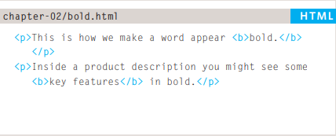
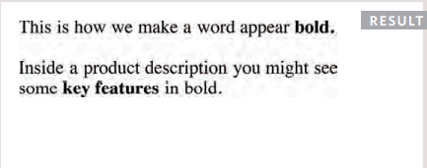
BOLD
Notes:
Notes to presenter:
Description of what you learned in your own words on one side.
Include information about the topic
Details about the topic will also be helpful here.
Tell the story of your learning experience. Just like a story there should always be a beginning, middle and an end.
On the other side, you can add a graphic that provides evidence of what you learned.
Feel free to use more than one slide to reflect upon your process. It also helps to add some video of your process.

Slide 38
ITALIC
<i>
By enclosing words in the tags <i> and </i> we can make characters appear bold.
The <i> element also represents a section of text that would be said in a different way from surrounding content — such as technical terms, names of ships, foreign words, thoughts, or other terms that would usually be italicized.
Notes:
Notes to presenter:
Description of what you learned in your own words on one side.
Include information about the topic
Details about the topic will also be helpful here.
Tell the story of your learning experience. Just like a story there should always be a beginning, middle and an end.
On the other side, you can add a graphic that provides evidence of what you learned.
Feel free to use more than one slide to reflect upon your process. It also helps to add some video of your process.

Slide 39
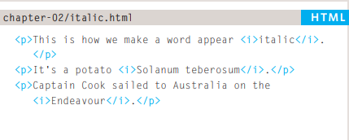
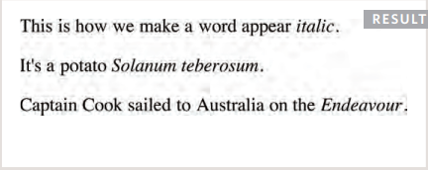
ITALIC
Notes:
Notes to presenter:
Description of what you learned in your own words on one side.
Include information about the topic
Details about the topic will also be helpful here.
Tell the story of your learning experience. Just like a story there should always be a beginning, middle and an end.
On the other side, you can add a graphic that provides evidence of what you learned.
Feel free to use more than one slide to reflect upon your process. It also helps to add some video of your process.

Slide 40
SUPERSCRIPT & SUBSCRIPT
<sup>
The <sup> element is used to contain characters that should be superscript such as the suffixes of dates or mathematical concepts like raising a number to a power such as 2² .
<sub>
The <sub> element is used to contain characters that should be subscript. It is commonly used with foot notes or chemical formulas such as H₂0
Notes:
Notes to presenter:
Description of what you learned in your own words on one side.
Include information about the topic
Details about the topic will also be helpful here.
Tell the story of your learning experience. Just like a story there should always be a beginning, middle and an end.
On the other side, you can add a graphic that provides evidence of what you learned.
Feel free to use more than one slide to reflect upon your process. It also helps to add some video of your process.

Slide 41
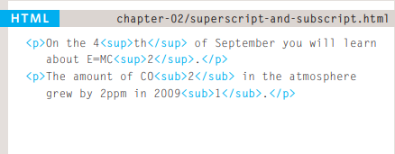
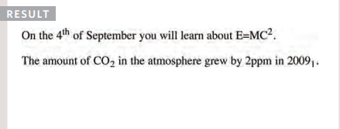
SUPERSCRIPT & SUBSCRIPT
Notes:
Notes to presenter:
Description of what you learned in your own words on one side.
Include information about the topic
Details about the topic will also be helpful here.
Tell the story of your learning experience. Just like a story there should always be a beginning, middle and an end.
On the other side, you can add a graphic that provides evidence of what you learned.
Feel free to use more than one slide to reflect upon your process. It also helps to add some video of your process.

Slide 42
SEMANTIC MARKUP
There are some text elements that are not intended to affect the structure of your web pages, but they do add extra information to the pages — they are known as semantic markup
In the rest of the chapter you will meet some more elements that will help you when you are adding text to web pages. For example, you are going to meet the <em> element that allows you to indicate where emphasis should be placed on selected words and the <blockquote>element which indicates that a block of text is a quotation.
Browsers often display the contents of these elements in a different way. For example, the content of the <em>element is shown in italics, and a <blockquote> is usually indented. But you should not use them to change the way that your text looks; their purpose is to describe the content of your web pages more accurately.
The reason for using these elements is that other programs, such as screen readers or search engines, can use this extra information. For example, the voice of a screen reader may add emphasis to the words inside the <em> element, or a search engine might register that your page features a quote if you use the <blockquote> element.
Notes:
Notes to presenter:
Description of what you learned in your own words on one side.
Include information about the topic
Details about the topic will also be helpful here.
Tell the story of your learning experience. Just like a story there should always be a beginning, middle and an end.
On the other side, you can add a graphic that provides evidence of what you learned.
Feel free to use more than one slide to reflect upon your process. It also helps to add some video of your process.

Slide 43
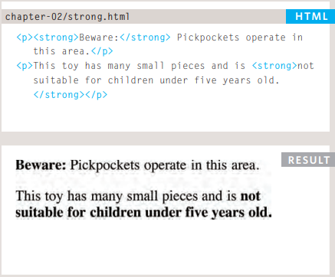
STRONG & EMPHASIS
<strong>
The use of the <strong> element indicates that its content has strong importance. For example, the words contained in this element might be said with strong emphasis.
By default, browsers will show the contents of a <strong> element in bold.
Notes:
Notes to presenter:
Description of what you learned in your own words on one side.
Include information about the topic
Details about the topic will also be helpful here.
Tell the story of your learning experience. Just like a story there should always be a beginning, middle and an end.
On the other side, you can add a graphic that provides evidence of what you learned.
Feel free to use more than one slide to reflect upon your process. It also helps to add some video of your process.

Slide 44
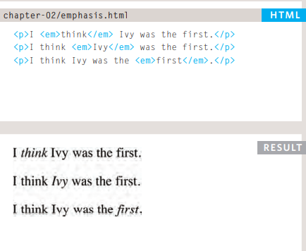
STRONG & EMPHASIS
<em>
The <em> element indicates emphasis that subtly changes the meaning of a sentence. By default browsers will show the contents of an <em> element in italic.
Notes:
Notes to presenter:
Description of what you learned in your own words on one side.
Include information about the topic
Details about the topic will also be helpful here.
Tell the story of your learning experience. Just like a story there should always be a beginning, middle and an end.
On the other side, you can add a graphic that provides evidence of what you learned.
Feel free to use more than one slide to reflect upon your process. It also helps to add some video of your process.

Slide 45
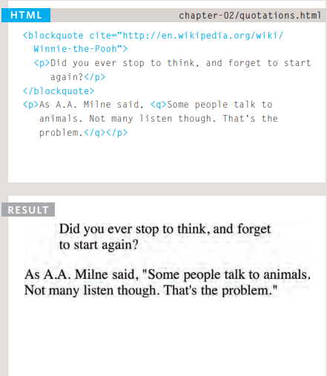
QUOTATIONS
There are two elements commonly used for marking up quotations:
<blockquote>
The <blockquote> element is used for longer quotes that take up an entire paragraph. Note how the <p> element is still used inside the <blockquote> element. Browsers tend to indent the contents of the <blockquote> element, however you should not use this element just to indent a piece of text — rather you should achieve this effect using CSS.
<q>
The <q> element is used for shorter quotes that sit within a paragraph. Browsers are supposed to put quotes around the <q> element, however Internet Explorer does not — therefore many people avoid using the <q> element. Both elements may use the cite attribute to indicate where the quote is from. Its value should be a URL that will have more information about the source of the quotation.
Notes:
Notes to presenter:
Description of what you learned in your own words on one side.
Include information about the topic
Details about the topic will also be helpful here.
Tell the story of your learning experience. Just like a story there should always be a beginning, middle and an end.
On the other side, you can add a graphic that provides evidence of what you learned.
Feel free to use more than one slide to reflect upon your process. It also helps to add some video of your process.

Slide 46
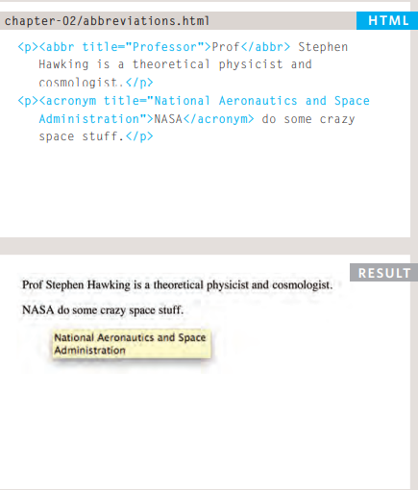
ABBREVIATIONS & ACRONYMS
<abbr> if you use an abbreviation or an acronym, then the <abbr> element can be used. A title attribute on the opening tag is used to specify the full term.
In HTML 4 there was a separate <acronym> element for acronyms. To spell out the full form of the acronym, the titleattribute was used (as with the <abbr> element above). HTML5 just uses the <abbr> element for both abbreviations and acronyms.
Notes:
Notes to presenter:
Description of what you learned in your own words on one side.
Include information about the topic
Details about the topic will also be helpful here.
Tell the story of your learning experience. Just like a story there should always be a beginning, middle and an end.
On the other side, you can add a graphic that provides evidence of what you learned.
Feel free to use more than one slide to reflect upon your process. It also helps to add some video of your process.

Slide 47
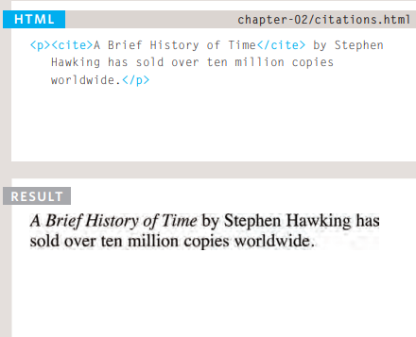
CITATIONS & DEFINITIONS
<cite>
When you are referencing a piece of work such as a book, film or research paper, the <cite> element can be used to indicate where the citation is from.
In HTML5, <cite> should not really be used for a person's name — but it was allowed in HTML 4, so most people are likely to continue to use it.
Browsers will render the content of a <cite> element in italics.
Notes:
Notes to presenter:
Description of what you learned in your own words on one side.
Include information about the topic
Details about the topic will also be helpful here.
Tell the story of your learning experience. Just like a story there should always be a beginning, middle and an end.
On the other side, you can add a graphic that provides evidence of what you learned.
Feel free to use more than one slide to reflect upon your process. It also helps to add some video of your process.

Slide 48
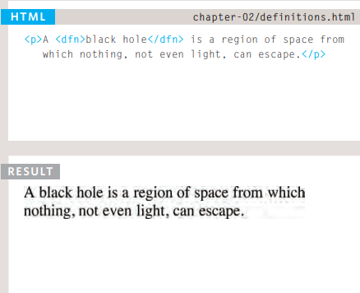
CITATIONS & DEFINITIONS
<dfn>
The first time you explain some new terminology (perhaps an academic concept or some jargon) in a document, it is known as the defining instance of it.
The <dfn> element is used to indicate the defining instance of a new term.
Some browsers show the content of the <dfn> element in italics. Safari and Chrome do not change its appearance.
Notes:
Notes to presenter:
Description of what you learned in your own words on one side.
Include information about the topic
Details about the topic will also be helpful here.
Tell the story of your learning experience. Just like a story there should always be a beginning, middle and an end.
On the other side, you can add a graphic that provides evidence of what you learned.
Feel free to use more than one slide to reflect upon your process. It also helps to add some video of your process.

Slide 49
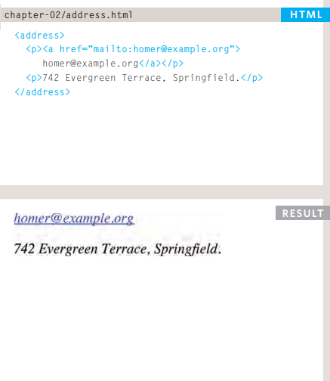
CITATIONS & DEFINITIONS
The <address> element has quite a specific use: to contain contact details for the author of the page.
It can contain a physical address, but it does not have to. For example, it may also contain a phone number or email address.
Browsers often display the content of the <address> element in italics.
You may also be interested in something called the hCard microformat for adding physical address information to your markup
Notes:
Notes to presenter:
Description of what you learned in your own words on one side.
Include information about the topic
Details about the topic will also be helpful here.
Tell the story of your learning experience. Just like a story there should always be a beginning, middle and an end.
On the other side, you can add a graphic that provides evidence of what you learned.
Feel free to use more than one slide to reflect upon your process. It also helps to add some video of your process.

Slide 50
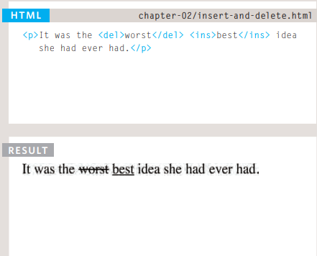
CHANGES TO CONTENT
<ins> <del>
The <ins> element can be used to show content that has been inserted into a document, while the <del> element can show text that has been deleted from it. The content of a <ins> element is usually underlined, while the content of a <del> element usually has a line through it.
Notes:
Notes to presenter:
Description of what you learned in your own words on one side.
Include information about the topic
Details about the topic will also be helpful here.
Tell the story of your learning experience. Just like a story there should always be a beginning, middle and an end.
On the other side, you can add a graphic that provides evidence of what you learned.
Feel free to use more than one slide to reflect upon your process. It also helps to add some video of your process.

Slide 51
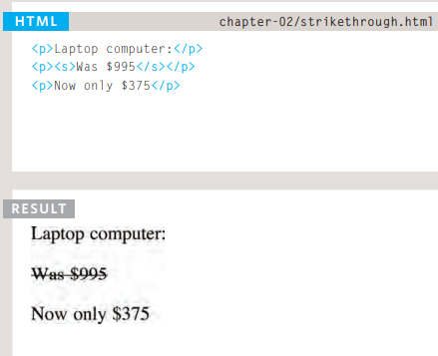
CHANGES TO CONTENT
<s>
The <s> element indicates something that is no longer accurate or relevant (but that should not be deleted).
Visually the content of an <s> element will usually be displayed with a line through the center.
Older versions of HTML had a <u> element for content that was underlined, but this is being phased out.
Notes:
Notes to presenter:
Description of what you learned in your own words on one side.
Include information about the topic
Details about the topic will also be helpful here.
Tell the story of your learning experience. Just like a story there should always be a beginning, middle and an end.
On the other side, you can add a graphic that provides evidence of what you learned.
Feel free to use more than one slide to reflect upon your process. It also helps to add some video of your process.

Slide 52
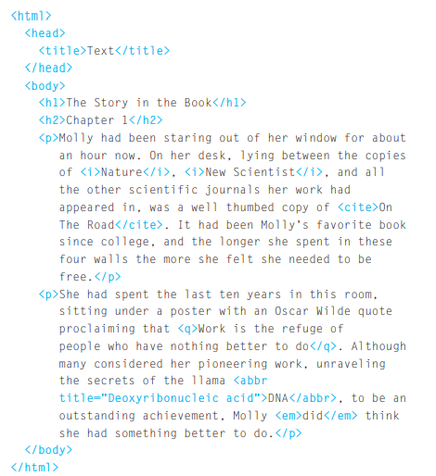
CHANGES TO CONTENT
This is a very simple HTML page that demonstrates text markup.
Structural markup includes elements such as <h1>, <h2>, and <p>.
Semantic information is carried in elements such as <cite> and <em>.
Notes:
Notes to presenter:
Description of what you learned in your own words on one side.
Include information about the topic
Details about the topic will also be helpful here.
Tell the story of your learning experience. Just like a story there should always be a beginning, middle and an end.
On the other side, you can add a graphic that provides evidence of what you learned.
Feel free to use more than one slide to reflect upon your process. It also helps to add some video of your process.

Slide 53
LISTS
Numbered lists
Bullet lists
Definition lists
Notes:
Notes to presenter:
What is your purpose for sharing this reflection?
Is it at the end of a unit or project?
Are you sharing this reflection, at the attainment of a learning goal you set for yourself?
Is it at the end of a course?
State your purpose for the reflection or even the purpose of the learning experience or learning goal. Be clear and be specific in stating your purpose.

Slide 54
LISTS
There are lots of occasions when we need to use lists. HTML provides us with three different types:
● Ordered lists are lists where each item in the list is numbered. For example, the list might be a set of steps for a recipe that must be performed in order, or a legal contract where each point needs to be identified by a section number.
● Unordered lists are lists that begin with a bullet point (rather than characters that indicate order).
● Definition lists are made up of a set of terms along with the definitions for each of those terms
Notes:
Notes to presenter:
Description of what you learned in your own words on one side.
Include information about the topic
Details about the topic will also be helpful here.
Tell the story of your learning experience. Just like a story there should always be a beginning, middle and an end.
On the other side, you can add a graphic that provides evidence of what you learned.
Feel free to use more than one slide to reflect upon your process. It also helps to add some video of your process.

Slide 55
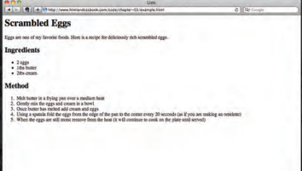
LISTS
Notes:
Notes to presenter:
Description of what you learned in your own words on one side.
Include information about the topic
Details about the topic will also be helpful here.
Tell the story of your learning experience. Just like a story there should always be a beginning, middle and an end.
On the other side, you can add a graphic that provides evidence of what you learned.
Feel free to use more than one slide to reflect upon your process. It also helps to add some video of your process.

Slide 56
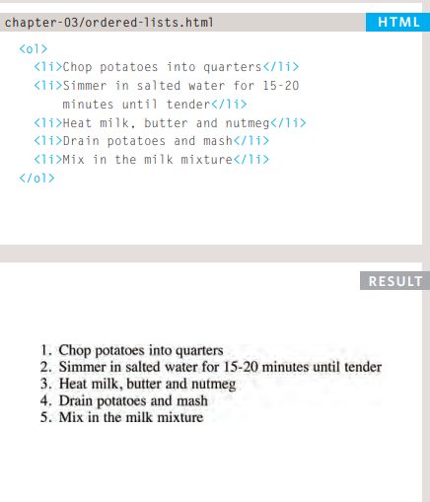
ORDERED LISTS
<ol> The ordered list is created with the <ol> element.
<li> Each item in the list is placed between an opening <li> tag and a closing </li> tag. (The listands for list item.)
Browsers indent lists by default.
Sometimes you may see a type attribute used with the <ol> element to specify the type of numbering (numbers, letters, roman numerals and so on).
Notes:
Notes to presenter:
Description of what you learned in your own words on one side.
Include information about the topic
Details about the topic will also be helpful here.
Tell the story of your learning experience. Just like a story there should always be a beginning, middle and an end.
On the other side, you can add a graphic that provides evidence of what you learned.
Feel free to use more than one slide to reflect upon your process. It also helps to add some video of your process.

Slide 57
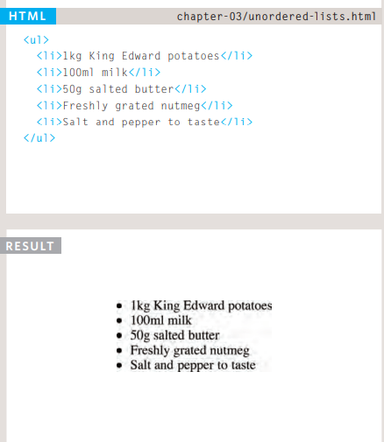
UNORDERED LISTS
<ul> The unordered list is created with the <ul> element.
<li> Each item in the list is placed between an opening <li> tag and a closing </li> tag. (The listands for list item.)
Browsers indent lists by default.
Sometimes you may see a type attribute used with the <ul> element to specify the type of bullet point (circles, squares, diamonds and so on). It is better to use the CSS list-styletype property covered on pages 333-335.
Notes:
Notes to presenter:
Description of what you learned in your own words on one side.
Include information about the topic
Details about the topic will also be helpful here.
Tell the story of your learning experience. Just like a story there should always be a beginning, middle and an end.
On the other side, you can add a graphic that provides evidence of what you learned.
Feel free to use more than one slide to reflect upon your process. It also helps to add some video of your process.

Slide 58
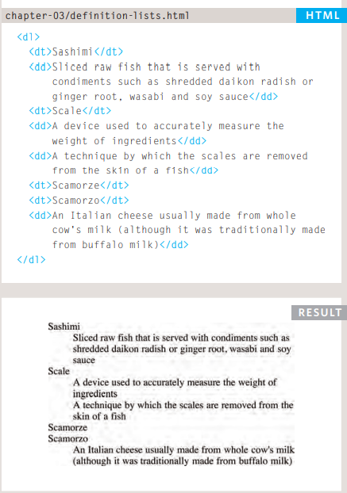
DEFINITION LISTS
<dl> The definition list is created with the <dl> element and usually consists of a series of terms and their definitions.
Inside the <dl> element you will usually see pairs of <dt> and <dd> elements.
<dt> This is used to contain the term being defined (the definition term).
<dd> This is used to contain the definition.
Sometimes you might see a list where there are two terms used for the same definition or two different definitions for the same term
Notes:
Notes to presenter:
Description of what you learned in your own words on one side.
Include information about the topic
Details about the topic will also be helpful here.
Tell the story of your learning experience. Just like a story there should always be a beginning, middle and an end.
On the other side, you can add a graphic that provides evidence of what you learned.
Feel free to use more than one slide to reflect upon your process. It also helps to add some video of your process.

Slide 59
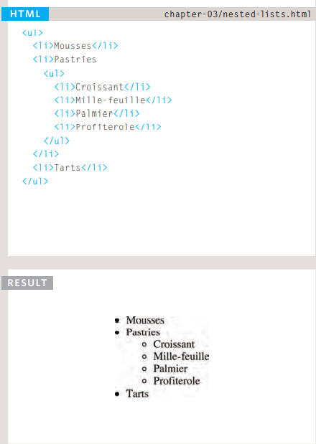
NESTED LISTS
You can put a second list inside an <li> element to create a sublist or nested list.
Browsers display nested lists indented further than the parent list. In nested unordered lists, the browser will usually change the style of the bullet point too.
Notes:
Notes to presenter:
Description of what you learned in your own words on one side.
Include information about the topic
Details about the topic will also be helpful here.
Tell the story of your learning experience. Just like a story there should always be a beginning, middle and an end.
On the other side, you can add a graphic that provides evidence of what you learned.
Feel free to use more than one slide to reflect upon your process. It also helps to add some video of your process.

Slide 60
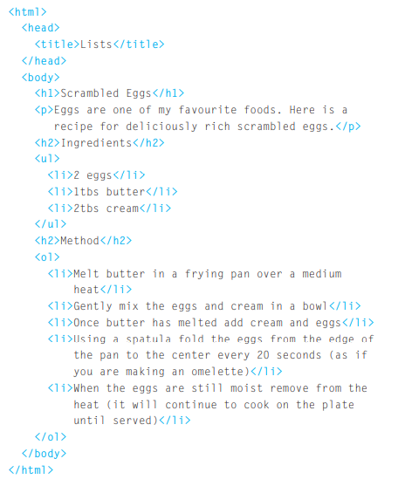
EXAMPLE LISTS
Here you can see a main heading followed by an introductory paragraph. An unordered list is used to outline the ingredients and an ordered list is used to describe the steps
Notes:
Notes to presenter:
Description of what you learned in your own words on one side.
Include information about the topic
Details about the topic will also be helpful here.
Tell the story of your learning experience. Just like a story there should always be a beginning, middle and an end.
On the other side, you can add a graphic that provides evidence of what you learned.
Feel free to use more than one slide to reflect upon your process. It also helps to add some video of your process.

Slide 61
LINKS
Creating links between pages
Linking to other sites
Email links
Notes:
Notes to presenter:
What is your purpose for sharing this reflection?
Is it at the end of a unit or project?
Are you sharing this reflection, at the attainment of a learning goal you set for yourself?
Is it at the end of a course?
State your purpose for the reflection or even the purpose of the learning experience or learning goal. Be clear and be specific in stating your purpose.

Slide 62
LINKS
Links are the defining feature of the web because they allow you to move from one web page to another — enabling the very idea of browsing or surfing. You will commonly come across the following types of links:
● Links from one website to another ● Links from one page to another on the same website ● Links from one part of a web page to another part of the same page ● Links that open in a new browser window ● Links that start up your email program and address a new email to someone
Notes:
Notes to presenter:
Description of what you learned in your own words on one side.
Include information about the topic
Details about the topic will also be helpful here.
Tell the story of your learning experience. Just like a story there should always be a beginning, middle and an end.
On the other side, you can add a graphic that provides evidence of what you learned.
Feel free to use more than one slide to reflect upon your process. It also helps to add some video of your process.

Slide 63
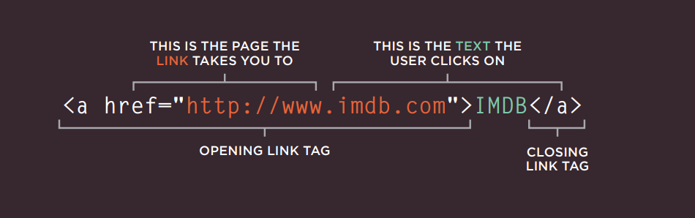
WRITING LINKS
Links are created using the element. Users can click on anything between the opening tag and the closing tag. You specify which page you want to link to using the href attribute.
Notes:
Notes to presenter:
Description of what you learned in your own words on one side.
Include information about the topic
Details about the topic will also be helpful here.
Tell the story of your learning experience. Just like a story there should always be a beginning, middle and an end.
On the other side, you can add a graphic that provides evidence of what you learned.
Feel free to use more than one slide to reflect upon your process. It also helps to add some video of your process.

Slide 64

WRITING LINKS
The text between the opening tag and closing tag is known as link text. Where possible, your link text should explain where visitors will be taken if they click on it (rather than just saying "click here"). Below you can see the link to IMDB that was created on the previous page.
Many people navigate websites by scanning the text for links. Clear link text can help visitors find what they want. This will give them a more positive impression of your site and may encourage them to visit it for longer. (It also helps people using screen reader software.)
To write good link text, you can think of words people might use when searching for the page that you are linking to. (For example, rather than write "places to stay" you could use something more specific such as "hotels in New York.")
Notes:
Notes to presenter:
Description of what you learned in your own words on one side.
Include information about the topic
Details about the topic will also be helpful here.
Tell the story of your learning experience. Just like a story there should always be a beginning, middle and an end.
On the other side, you can add a graphic that provides evidence of what you learned.
Feel free to use more than one slide to reflect upon your process. It also helps to add some video of your process.

Slide 65
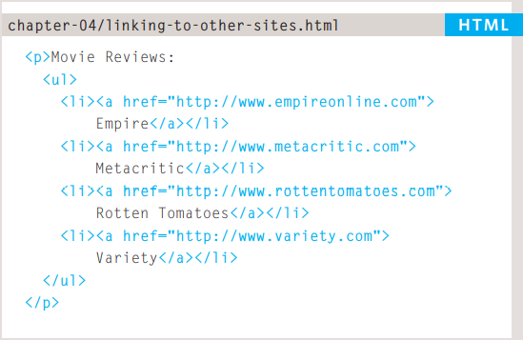
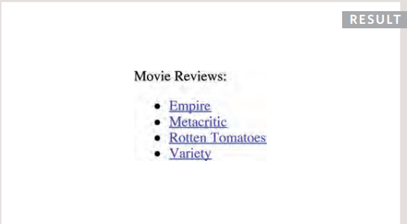
LINKING TO OTHER SITES
Links are created using the <a> element which has an attribute called href. The value of the href attribute is the page that you want people to go to when they click on the link. Users can click on anything that appears between the opening <a> tag and the closing </a> tag and will be taken to the page specified in the href attribute. When you link to a different website, the value of the href attribute will be the full web address for the site, which is known as an absolute URL. Browsers show links in blue with an underline by default.
ABSOLUTE URLS URL stands for Uniform Resource Locator. Every web page has its own URL. This is the web address that you would type into a browser if you wanted to visit that specific page. URL stands for Uniform Resource Locator. Every web page has its own URL. This is the web address that you would type into a browser if you wanted to visit that specific page.
Notes:
Notes to presenter:
Description of what you learned in your own words on one side.
Include information about the topic
Details about the topic will also be helpful here.
Tell the story of your learning experience. Just like a story there should always be a beginning, middle and an end.
On the other side, you can add a graphic that provides evidence of what you learned.
Feel free to use more than one slide to reflect upon your process. It also helps to add some video of your process.

Slide 66
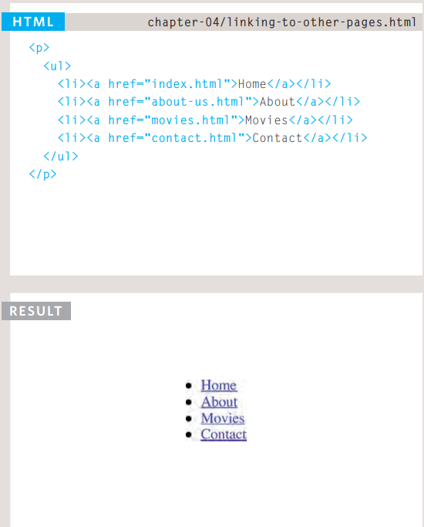
LINKING TO OTHER PAGES ON THE SAME SITE
<a> When you are linking to other pages within the same site, you do not need to specify the domain name in the URL. You can use a shorthand known as a relative URL. If all the pages of the site are in the same folder, then the value of the href attribute is just the name of the file. If you have different pages of a site in different folders, then you can use a slightly more complex syntax to indicate where the page is in relation to the current page. You will learn more about these on the pages 81-84. If you look at the download code for each chapter, you will see that the index.html file contains links that use relative URLs
RELATIVE URLS When linking to other pages within the same site, you can use relative URLs. These are like a shorthand version of absolute URLs because you do not need to specify the domain name. When linking to other pages within the same site, you can use relative URLs. These are like a shorthand version of absolute URLs because you do not need to specify the domain name. Relative URLs help when building a site on your computer because you can create links between pages without having to set up your domain name or hosting.
Notes:
Notes to presenter:
Description of what you learned in your own words on one side.
Include information about the topic
Details about the topic will also be helpful here.
Tell the story of your learning experience. Just like a story there should always be a beginning, middle and an end.
On the other side, you can add a graphic that provides evidence of what you learned.
Feel free to use more than one slide to reflect upon your process. It also helps to add some video of your process.

Slide 67
DIRECTORY STRUCTURE
On larger websites it's a good idea to organize your code by placing the pages for each different section of the site into a new folder. Folders on a website are sometimes referred to as directories.
STRUCTURE The diagram on the right shows the directory structure for a fictional entertainment listings website called ExampleArts. The top-level folder is known as the root folder. (In this example, the root folder is called examplearts.) The root folder contains all of the other files and folders for a website. Each section of the site is placed in a separate folder; this helps organize the files.
RELATIONSHIPS The relationship between files and folders on a website is described using the same terminology as a family tree. In the diagram on the right, you can see some relationships have been drawn in. The examplearts folder is a parent of the movies, music and theater folders. And the the movies, music and theater folders are children of the examplearts folder
HOMEPAGES The main homepage of a site written in HTML (and the homepages of each section in a child folder) is called index.html. Web servers are usually set up to return the index.html file if no file name is specified. Therefore, if you enter examplearts.com it will return examplearts.com/index .html, and examplearts.com/ music will return examplearts .com/music/index.html.
If you are working with a content management system, blogging software, or an e-commerce system, you might not have individual files for each page of the website. Instead, these systems often use one template file for each different type of page (such as news articles, blog posts, or products). Editing the template file would change all of the pages that use that template. Do not change any code that is not HTML or you may break the page.
Notes:
Notes to presenter:
Description of what you learned in your own words on one side.
Include information about the topic
Details about the topic will also be helpful here.
Tell the story of your learning experience. Just like a story there should always be a beginning, middle and an end.
On the other side, you can add a graphic that provides evidence of what you learned.
Feel free to use more than one slide to reflect upon your process. It also helps to add some video of your process.

Slide 68
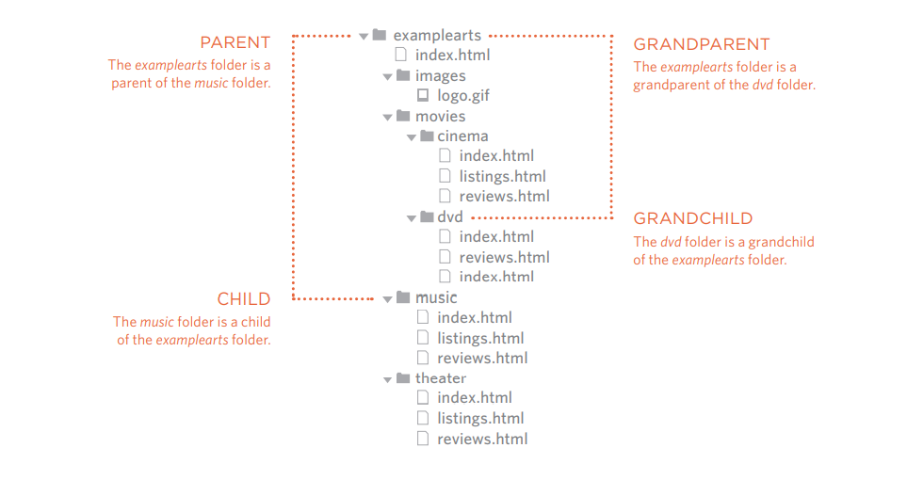
DIRECTORY STRUCTURE
Every page and every image on a website has a URL (or Uniform Resource Locator). The URL is made up of the domain name followed by the path to that page or image. The path to the homepage of this site is www.examplearts .com/index.html. The path to the logo for the site is examplearts.com/images/ logo.gif. You use URLs when linking to other web pages and when including images in your own site. On the next page, you will meet a shorthand way to link to files on your own site.
The root folder contains: ● A file called index.html which is the homepage for the entire site ● Individual folders for the movies, music and theatre sections of the site Each sub-directory contains: ● A file called index.html which is the homepage for that section ● A reviews page called reviews .html ● A listings page called listings .html (except for the DVD section) The movies section contains: ● A folder called cinema ● A folder called DVD.
Notes:
Notes to presenter:
Description of what you learned in your own words on one side.
Include information about the topic
Details about the topic will also be helpful here.
Tell the story of your learning experience. Just like a story there should always be a beginning, middle and an end.
On the other side, you can add a graphic that provides evidence of what you learned.
Feel free to use more than one slide to reflect upon your process. It also helps to add some video of your process.

Slide 69
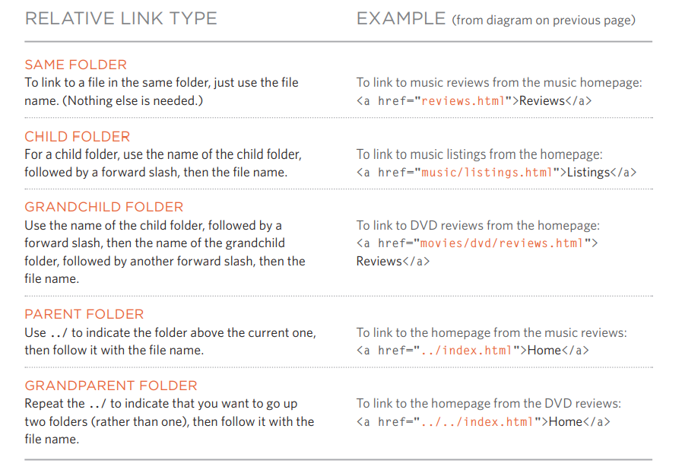
RELATIVE URLS
Relative URLs can be used when linking to pages within your own website. They provide a shorthand way of telling the browser where to find your files.
Notes:
Notes to presenter:
Description of what you learned in your own words on one side.
Include information about the topic
Details about the topic will also be helpful here.
Tell the story of your learning experience. Just like a story there should always be a beginning, middle and an end.
On the other side, you can add a graphic that provides evidence of what you learned.
Feel free to use more than one slide to reflect upon your process. It also helps to add some video of your process.

Slide 70
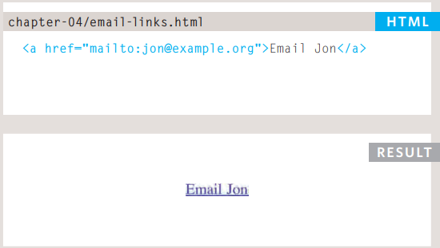
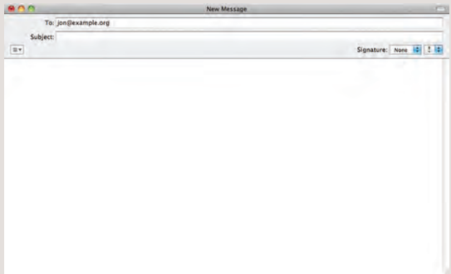
EMAIL LINKS
mailto: To create a link that starts up the user's email program and addresses an email to a specified email address, you use the element. However, this time the value of the href attribute starts with mailto: and is followed by the email address you want the email to be sent to. On the right you can see that an email link looks just like any other link but, when it is clicked on, the user's email program will open a new email message and address it to the person specified in the link.
Notes:
Notes to presenter:
Description of what you learned in your own words on one side.
Include information about the topic
Details about the topic will also be helpful here.
Tell the story of your learning experience. Just like a story there should always be a beginning, middle and an end.
On the other side, you can add a graphic that provides evidence of what you learned.
Feel free to use more than one slide to reflect upon your process. It also helps to add some video of your process.

Slide 71
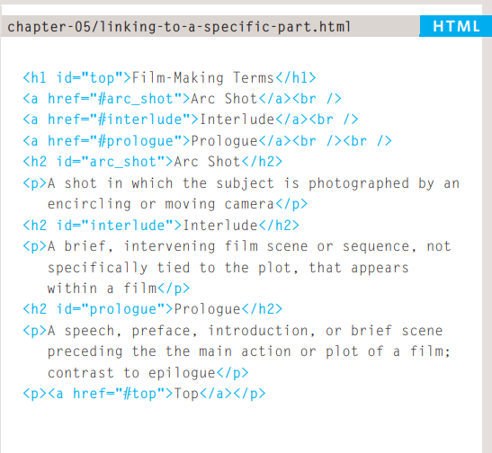
LINKING TO A SPECIFIC PART OF THE SAME PAGE
At the top of a long page you might want to add a list of contents that links to the corresponding sections lower down. Or you might want to add a link from part way down the page back to the top of it to save users from having to scroll back to the top. Before you can link to a specific part of a page, you need to identify the points in the page that the link will go to. You do this using the id attribute (which can be used on every HTML element). You can see that the <h1> and <h2> elements in this example have been given id attributes that identify those sections of the page. The value of the id attribute should start with a letter or an underscore (not a number or any other character) and, on a single page, no two id attributes should have the same value. To link to an element that uses an id attribute you use the element again, but the value of the href attribute starts with the # symbol, followed by the value of the id attribute of the element you want to link to. In this example, <a href=“#top”> links to the <h1> element at the top of the page whose id attribute has a value of top.
Notes:
Notes to presenter:
Description of what you learned in your own words on one side.
Include information about the topic
Details about the topic will also be helpful here.
Tell the story of your learning experience. Just like a story there should always be a beginning, middle and an end.
On the other side, you can add a graphic that provides evidence of what you learned.
Feel free to use more than one slide to reflect upon your process. It also helps to add some video of your process.

Slide 72
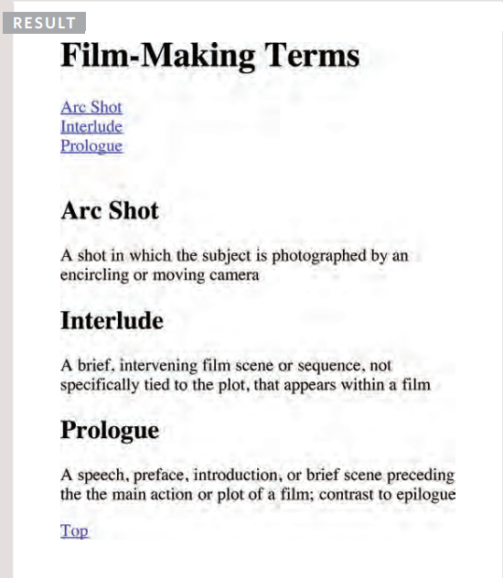
LINKING TO A SPECIFIC PART OF THE SAME PAGE
If you want to link to a specific part of a different page (whether on your own site or a different website) you can use a similar technique. As long as the page you are linking to has id attributes that identify specific parts of the page, you can simply add the same syntax to the end of the link for that page. Therefore, the href attribute will contain the address for the page (either an absolute URL or a relative URL), followed by the # symbol, followed by the value of the id attribute that is used on the element you are linking to.
Notes:
Notes to presenter:
Description of what you learned in your own words on one side.
Include information about the topic
Details about the topic will also be helpful here.
Tell the story of your learning experience. Just like a story there should always be a beginning, middle and an end.
On the other side, you can add a graphic that provides evidence of what you learned.
Feel free to use more than one slide to reflect upon your process. It also helps to add some video of your process.

Slide 73
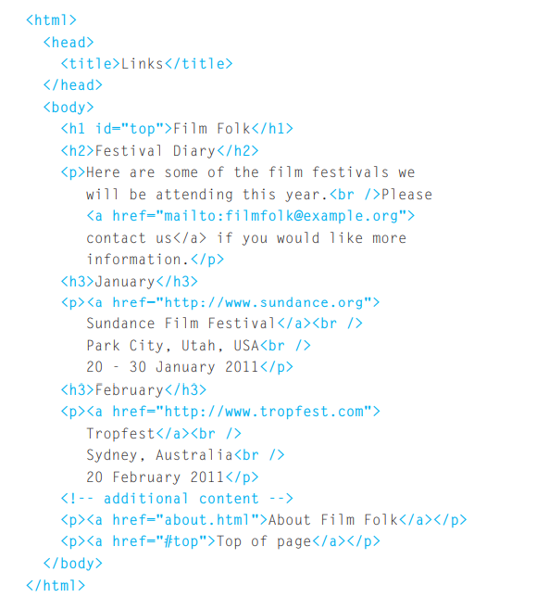
EXAMPLE LINKS
This example is of a web page about film This <h1> example is of a web page about film. The element is used with an id attribute at the top of the page so that a link can be added to take readers from the bottom of the page to the top. There is an email link to allow readers to contact the author of the web page. There are also a number of links to qualified URLs. These link to various film festivals. Below this list is a link to a relative URL which is an "about" page that lives in the same directory
Notes:
Notes to presenter:
Description of what you learned in your own words on one side.
Include information about the topic
Details about the topic will also be helpful here.
Tell the story of your learning experience. Just like a story there should always be a beginning, middle and an end.
On the other side, you can add a graphic that provides evidence of what you learned.
Feel free to use more than one slide to reflect upon your process. It also helps to add some video of your process.

Slide 74
IMAGES
How to add images to pages
Choosing the right format
Optimizing images for the web
Notes:
Notes to presenter:
What is your purpose for sharing this reflection?
Is it at the end of a unit or project?
Are you sharing this reflection, at the attainment of a learning goal you set for yourself?
Is it at the end of a course?
State your purpose for the reflection or even the purpose of the learning experience or learning goal. Be clear and be specific in stating your purpose.

Slide 75
IMAGES
There are many reasons why you might want to add an image to a web page: you might want to include a logo, photograph, illustration, diagram, or chart. There are several things to consider when selecting and preparing images for your site, but taking time to get them right will make it look more attractive and professional. In this chapter you will learn how to:
Include an image in your web pages using HTML
Pick which image format to use
Show an image at the right size
Optimize an image for use on the web to make pages load faster
Notes:
Notes to presenter:
Description of what you learned in your own words on one side.
Include information about the topic
Details about the topic will also be helpful here.
Tell the story of your learning experience. Just like a story there should always be a beginning, middle and an end.
On the other side, you can add a graphic that provides evidence of what you learned.
Feel free to use more than one slide to reflect upon your process. It also helps to add some video of your process.

Slide 76
CHOOSING IMAGES FOR YOU SITE
A picture can say a thousand words, and great images help make the difference between an average-looking site and a really engaging one.
Images can be used to set the tone for a site in less time than it takes to read a description. If you do not have photographs to use on your website, there are companies who sell stock images; these are images you
pay to use (there is a list of stock photography websites below). Remember that all images are subject to copyright, and you can get in trouble for simply taking photographs from another website.
If you have a page that shows several images (such as product photographs or members of a team) then putting them on a simple, consistent background helps them look better as a group.
Images should...
Stock photos
ONLINE EXTRA
Be relevant
Convey information
Convey the right mood
Be instantly recognisable
Fit the color palette
www.istockphoto.com www.gettyimages.com www.veer.com www.sxc.hu www.fotolia.com
We have provided an online gallery that helps you choose the right image for your website. You can find it in the tools section of the site accompanying this book.
Notes:
Notes to presenter:
Description of what you learned in your own words on one side.
Include information about the topic
Details about the topic will also be helpful here.
Tell the story of your learning experience. Just like a story there should always be a beginning, middle and an end.
On the other side, you can add a graphic that provides evidence of what you learned.
Feel free to use more than one slide to reflect upon your process. It also helps to add some video of your process.

Slide 77

STORING IMAGES ON YOUR SITE
If you are building a site from scratch, it is good practice to create a folder for all of the images the site uses.
As a website grows, keeping images in a separate folder helps you understand how the site is organized. Here you can see an example of the files for a website; all of the images are stored in a folder called images.
On a big site you might like to add subfolders inside the images folder. For example, images such as logos and buttons might sit in a folder called interface, product photographs might sit in a page called products, and images related to news might live in a folder called news.
If you are using a content management system or blogging platform, there are usually tools built into the admin site that allow you to upload images, and the program will probably already have a separate folder for image files and any other uploads.
Notes:
Notes to presenter:
Description of what you learned in your own words on one side.
Include information about the topic
Details about the topic will also be helpful here.
Tell the story of your learning experience. Just like a story there should always be a beginning, middle and an end.
On the other side, you can add a graphic that provides evidence of what you learned.
Feel free to use more than one slide to reflect upon your process. It also helps to add some video of your process.

Slide 78

ADDING IMAGES
Title You can also use the title attribute with the <img> element to provide additional information about the image. Most browsers will display the content of this attribute in a tootip when the user hovers over the image.
You can also use the title attribute with the <img> element to provide additional information about the image. Most browsers will display the content of this attribute in a tootip when the user hovers over the image.
If the image is just to make a page look more attractive (and it has no meaning, such as a graphic dividing line), then the alt attribute should still be used but the quotes should be left empty.
<img> To add an image into the page you need to use an <img> element. This is an empty element (which means there is no closing tag). It must carry the following two attributes: SRC This tells the browser where it can find the image file. This will usually be a relative URL pointing to an image on your own site. (Here you can see that the images are in a child folder called images — relative URLs were covered on pages 83-84). ALT This provides a text description of the image which describes the image if you cannot see it.
Notes:
Notes to presenter:
Description of what you learned in your own words on one side.
Include information about the topic
Details about the topic will also be helpful here.
Tell the story of your learning experience. Just like a story there should always be a beginning, middle and an end.
On the other side, you can add a graphic that provides evidence of what you learned.
Feel free to use more than one slide to reflect upon your process. It also helps to add some video of your process.

Slide 79

HEIGHT & WIDTH OF IMAGES
You will also often see an <img> element use two other attributes that specify its size:
Height This specifies the height of the image in pixels.
Width This specifies the width of the image in pixels.Images often take longer to load than the HTML code that makes up the rest of the page. It is, therefore, a good idea to specify the size of the image so that the browser can render the rest of the text on the page while leaving the right amount of space for the image that is still loading.
Notes:
Notes to presenter:
Description of what you learned in your own words on one side.
Include information about the topic
Details about the topic will also be helpful here.
Tell the story of your learning experience. Just like a story there should always be a beginning, middle and an end.
On the other side, you can add a graphic that provides evidence of what you learned.
Feel free to use more than one slide to reflect upon your process. It also helps to add some video of your process.

Slide 80

WHERE TO PLACE IMAGES IN YOUR CODE
Where an image is placed in the code will affect how it is displayed. Here are three examples of image placement that produce different results:
1: Before a paragraph The paragraph starts on a new line after the image.
2: Inside the start of a paragraph The first row of text aligns with the bottom of the image.
3: In the middle of a paragraph The image is placed between the words of the paragraph that it appears in.
Notes:
Notes to presenter:
Description of what you learned in your own words on one side.
Include information about the topic
Details about the topic will also be helpful here.
Tell the story of your learning experience. Just like a story there should always be a beginning, middle and an end.
On the other side, you can add a graphic that provides evidence of what you learned.
Feel free to use more than one slide to reflect upon your process. It also helps to add some video of your process.

Slide 81

WHERE TO PLACE IMAGES IN YOUR CODE
Where you place the image in the code is important because browsers show HTML elements in one of two ways:
Block elements always appear on a new line. Examples of block elements include the <h1> and <p> elements.
If the <img> is followed by a block level element (such as a paragraph) then the block level element will sit on a new line after the imageas shown in the first example on this page.
Inline elements sit within a block level element and do not start on a new line. Examples of inline elements include the <b>, <em>, and <img> elements.
If the <img> element is inside a block level element, any text or other inline elements will flow around the image as shown in the second and third examples on this page
Notes:
Notes to presenter:
Description of what you learned in your own words on one side.
Include information about the topic
Details about the topic will also be helpful here.
Tell the story of your learning experience. Just like a story there should always be a beginning, middle and an end.
On the other side, you can add a graphic that provides evidence of what you learned.
Feel free to use more than one slide to reflect upon your process. It also helps to add some video of your process.

Slide 82
THREE RULES FOR CREATING IMAGES
There are three rules to remember when you are creating images for your website which are summarized below.
1
2
3
Save images in the right format
Save images at the right size
Use the correct resolution
Websites mainly use images in jpeg, gif, or png format. If you choose the wrong image format then your image might not look as sharp as it should and can make the web page slower to load.
You should save the image at the same width and height it will appear on the website. If the image is smaller than the width or height that you have specified, the image can be distorted and stretched. If the image is larger than the width and height if you have specified, the image will take longer to display on the page.
Computer screens are made up of dots known as pixels. Images used on the web are also made up of tiny dots. Resolution refers to the number of dots per inch, and most computer screens only show web pages at 72 pixels per inch. So saving images at a higher resolution results in images that are larger than necessary and take longer to download.
Notes:
Notes to presenter:
Description of what you learned in your own words on one side.
Include information about the topic
Details about the topic will also be helpful here.
Tell the story of your learning experience. Just like a story there should always be a beginning, middle and an end.
On the other side, you can add a graphic that provides evidence of what you learned.
Feel free to use more than one slide to reflect upon your process. It also helps to add some video of your process.

Slide 83

IMAGE DIMENSIONS
The images you use on your website should be saved at the same width and height that you want them to appear on the page.
Notes:
Notes to presenter:
Description of what you learned in your own words on one side.
Include information about the topic
Details about the topic will also be helpful here.
Tell the story of your learning experience. Just like a story there should always be a beginning, middle and an end.
On the other side, you can add a graphic that provides evidence of what you learned.
Feel free to use more than one slide to reflect upon your process. It also helps to add some video of your process.

Slide 84
CROPPING IMAGES
The images you use on your website should be saved at the same width and height that you want them to appear on the page.
Notes:
Notes to presenter:
Description of what you learned in your own words on one side.
Include information about the topic
Details about the topic will also be helpful here.
Tell the story of your learning experience. Just like a story there should always be a beginning, middle and an end.
On the other side, you can add a graphic that provides evidence of what you learned.
Feel free to use more than one slide to reflect upon your process. It also helps to add some video of your process.

Slide 85

IMAGE DIMENSIONS
The images you use on your website should be saved at the same width and height that you want them to appear on the page.
Notes:
Notes to presenter:
Description of what you learned in your own words on one side.
Include information about the topic
Details about the topic will also be helpful here.
Tell the story of your learning experience. Just like a story there should always be a beginning, middle and an end.
On the other side, you can add a graphic that provides evidence of what you learned.
Feel free to use more than one slide to reflect upon your process. It also helps to add some video of your process.

Slide 86

HTML5: FIGURE AND FIGURE CAPTION
<figure> Images often come with captions. HTML5 has introduced a new <figure> element to contain images and their caption so that the two are associated. You can have more than one image inside the <figure> element as long as they all share the same caption.
<figcaption> The <figcaption> element has been added to HTML5 in order to allow web page authors to add a caption to an image.Before these elements were created there was no way to associate an <img> element with its caption.
Notes:
Notes to presenter:
Description of what you learned in your own words on one side.
Include information about the topic
Details about the topic will also be helpful here.
Tell the story of your learning experience. Just like a story there should always be a beginning, middle and an end.
On the other side, you can add a graphic that provides evidence of what you learned.
Feel free to use more than one slide to reflect upon your process. It also helps to add some video of your process.

Slide 87

EXAMPLE IMAGES
Notes:
Notes to presenter:
Description of what you learned in your own words on one side.
Include information about the topic
Details about the topic will also be helpful here.
Tell the story of your learning experience. Just like a story there should always be a beginning, middle and an end.
On the other side, you can add a graphic that provides evidence of what you learned.
Feel free to use more than one slide to reflect upon your process. It also helps to add some video of your process.

Slide 88
TABLES
How to create tables
What information suits tables
How to present complex data in tables
Notes:
Notes to presenter:
What is your purpose for sharing this reflection?
Is it at the end of a unit or project?
Are you sharing this reflection, at the attainment of a learning goal you set for yourself?
Is it at the end of a course?
State your purpose for the reflection or even the purpose of the learning experience or learning goal. Be clear and be specific in stating your purpose.

Slide 89
TABLES
There are several types of information that need to be displayed in a grid or table. For example: sports results, stock reports, train timetables. There are several types of information that need to be displayed in a grid or table. For example: sports results, stock reports, train timetables. ● Use the four key elements for creating tables ● Represent complex data using tables ● Add captions to tables
Notes:
Notes to presenter:
Description of what you learned in your own words on one side.
Include information about the topic
Details about the topic will also be helpful here.
Tell the story of your learning experience. Just like a story there should always be a beginning, middle and an end.
On the other side, you can add a graphic that provides evidence of what you learned.
Feel free to use more than one slide to reflect upon your process. It also helps to add some video of your process.

Slide 90

WHAT’S A TABLE?
A table represents information in a grid format. Examples of tables include financial reports, TV schedules, and sports results.
Grids allow us to understand complex data by referencing information on two axes. Each block in the grid is referred to as a table cell. In HTML a table is written out row by row.
Notes:
Notes to presenter:
Description of what you learned in your own words on one side.
Include information about the topic
Details about the topic will also be helpful here.
Tell the story of your learning experience. Just like a story there should always be a beginning, middle and an end.
On the other side, you can add a graphic that provides evidence of what you learned.
Feel free to use more than one slide to reflect upon your process. It also helps to add some video of your process.

Slide 91

BASIC TABLE STRUCTURE
A table represents information in a grid format. Examples of tables include financial reports, TV schedules, and sports results.
<table> The <table> element is used to create a table. The contents of the table are written out row by row.
<tr> You indicate the start of each row using the opening <tr> tag. (The tr stands for table row.) It is followed by one or more <td> elements (one for each cell in that row). At the end of the row you use a closing </tr> tag.
<td>
Each cell of a table is represented using a <td> element. (The td stands for table data.)At the end of each cell you use a closing </td> tag.
Notes:
Notes to presenter:
Description of what you learned in your own words on one side.
Include information about the topic
Details about the topic will also be helpful here.
Tell the story of your learning experience. Just like a story there should always be a beginning, middle and an end.
On the other side, you can add a graphic that provides evidence of what you learned.
Feel free to use more than one slide to reflect upon your process. It also helps to add some video of your process.

